Slide 1
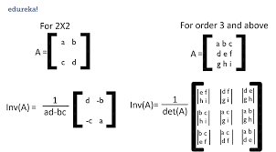
Linear Algebra For Machine Learning
Scalars, Vectors, and Matrices
Vector and Matrix Operations
Dot Product, Norm, and Angle Between Vectors
Linear Equations and Matrix Inverse
Linear Transformations and Projections
Eigenvalues, Eigenvectors & Intro to PCA

Slide 2
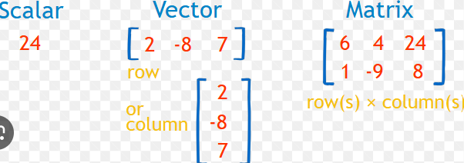
Linear Algebra For Machine Learning
What is Scaler?
What is Vector?
What is Matrix

Slide 3
Age | Salary | Experience | Purchased
25 | 50000 | 2 | 0
32 | 62000 | 5 | 1
47 | 75000 | 10 | 1
29 | 58000 | 3 | 0

Slide 4
What is scaler?
Scalar:
A scalar is a single number – just one value.
Example:
a=5 or b=−3.14
A scalar has magnitude but no direction.
For example, if the scalar is -5, its magnitude is |−5| = 5. Magnitude gives you the "size" or "length" of a scalar without considering its direction (sign).
In machine learning, a scalar might represent:
A single weight in a linear regression model.
A loss value (like MSE or cross-entropy).
A learning rate.

Slide 5
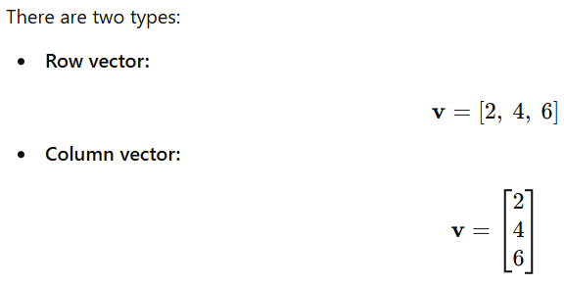
What is Vector?
A vector is an ordered array of numbers – think of it as a list or a column of scalars. It has both magnitude and direction.
In ML:
Each data point (e.g., an image pixel row, user preferences, or features in a dataset) is a vector.
Word embeddings like Word2Vec or BERT embeddings are high-dimensional vectors.

Slide 6
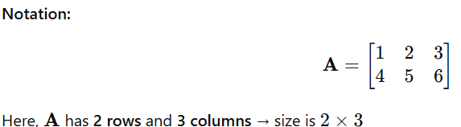
What is Matrix?
Matrix:
A matrix is a 2D grid of numbers – essentially a table with rows and columns.
Use in ML:
A dataset is usually represented as a matrix where:
Rows = examples (samples)
Columns = features (attributes)
For example, a dataset with 1000 samples and 10 features = matrix of size 1000×10

Slide 7
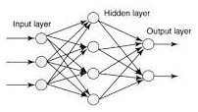
Example 1: Dataset as a Matrix
Imagine a dataset of house prices with 3 features:
Size (sqft)
No. of bedrooms
Age of the house
A single data point (vector):
Size | No of Bedrooms | Age
1000 sqf | 10 | 3 years
1000 sqf | 10 | 3 years
Example 2: Neural Networks
Inputs to a layer = vector
Weights = matrix
Output = vector (after activation)

Slide 8
Summary Table:
Term | Definition | ML Example
Scalar | Single number | Loss value, learning rate
Vector | 1D array (magnitude & direction) | Feature vector, embeddings
Matrix | 2D array of numbers | Dataset, weight matrix

